Slide 1
Gun Violence in America
Jessica Everett
8/11/2019

Slide 2
Data Set
Data Set: Gun Violence Data
Retrieved from: https://www.kaggle.com/jameslko/gun-violence-data/downloads/gun-violence-data.zip/1
Subject: This dataset includes all gun violence incidences in the USA between 2013 and 2018.
Variables include: date, state, number killed, number injured, and number of guns involved in the incident.

Slide 3
Variables
date: The date of the gun violence incident
state: The state where the incident occurred
n_guns_involved: The number of guns involved
n_injured: The number of people injured
n_killed: The number of people killed

Slide 4
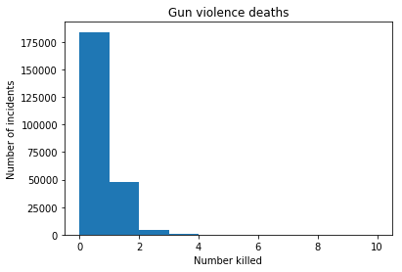
Histogram of n_killed

Slide 5
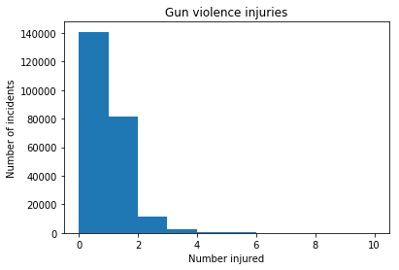
Histogram of n_injured

Slide 6
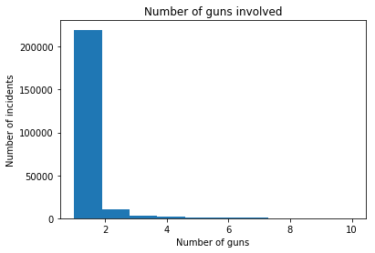
Histogram of n_guns_involved

Slide 7
Describe state and date
The most common state for gun violence is Illinois
Mode of state = Illinois
The single day with the most gun violence incidents was January 1, 2017
Mode of date = 2017-01-01

Slide 8
Describe n_killed
Mean: 0.25
Mode: 0
Variance: 0.26
Standard deviation: 0.51

Slide 9
Describe n_injured
Mean: 0.49
Mode: 0
Variance: 0.5
Standard deviation: 0.71

Slide 10
Describe n_guns_involved
Mean: 1.18
Mode: 1
Variance: 0.49
Standard deviation: 0.7

Slide 11
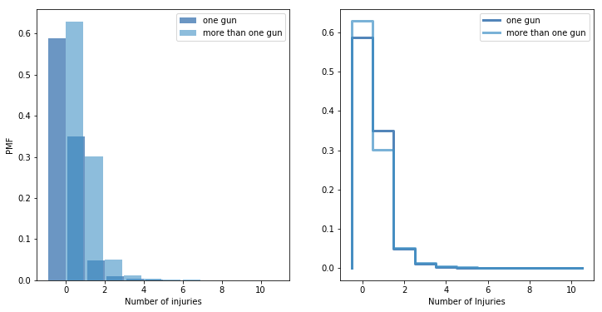
PMF to Compare Scenarios

Slide 12
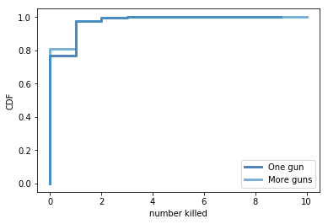
CDF to Compare Scenarios

Slide 13
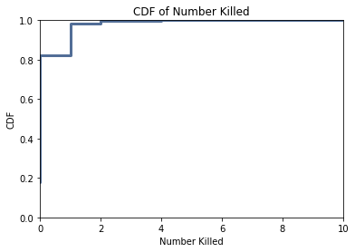
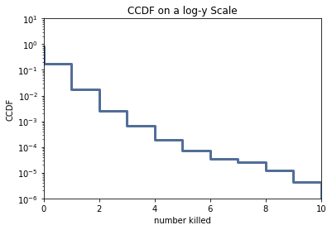
Analytic Distribution

Slide 14
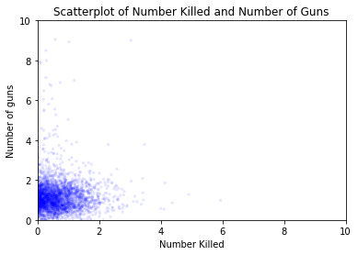
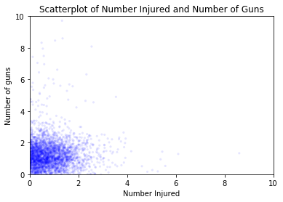
Scatterplots

Slide 15
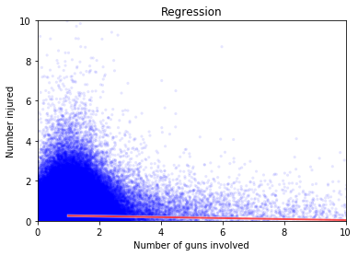
Regression

